Slide 1
apresentacao2 | Tableau Public
https://public.tableau.com/app/profile/andre.camara/viz/apresentacao2/Painel1?publish=yes

Slide 2
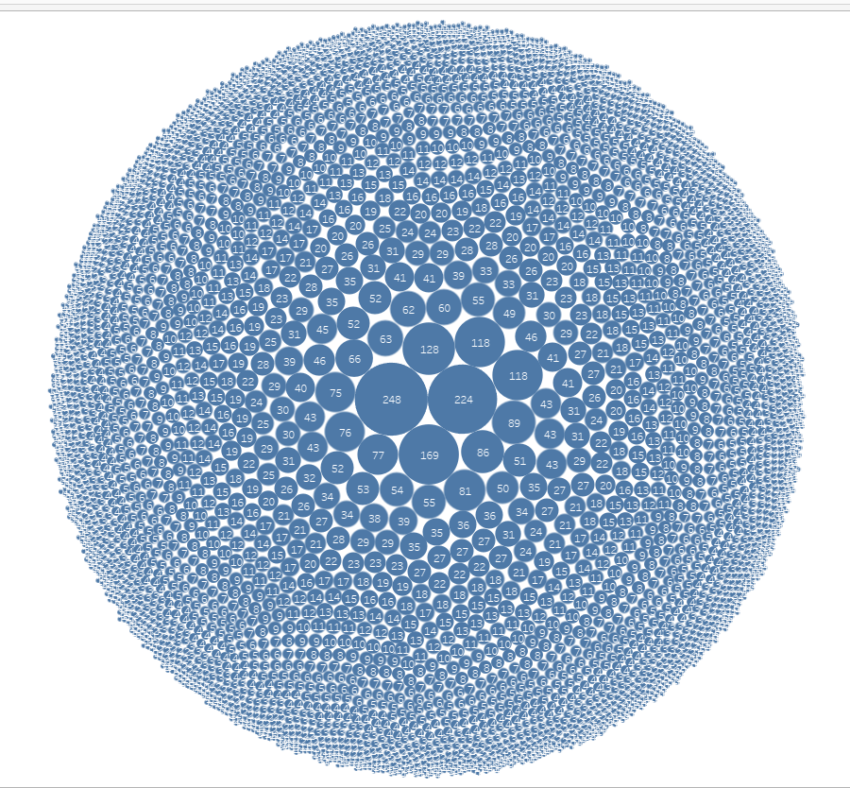
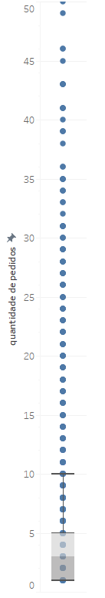

Slide 3
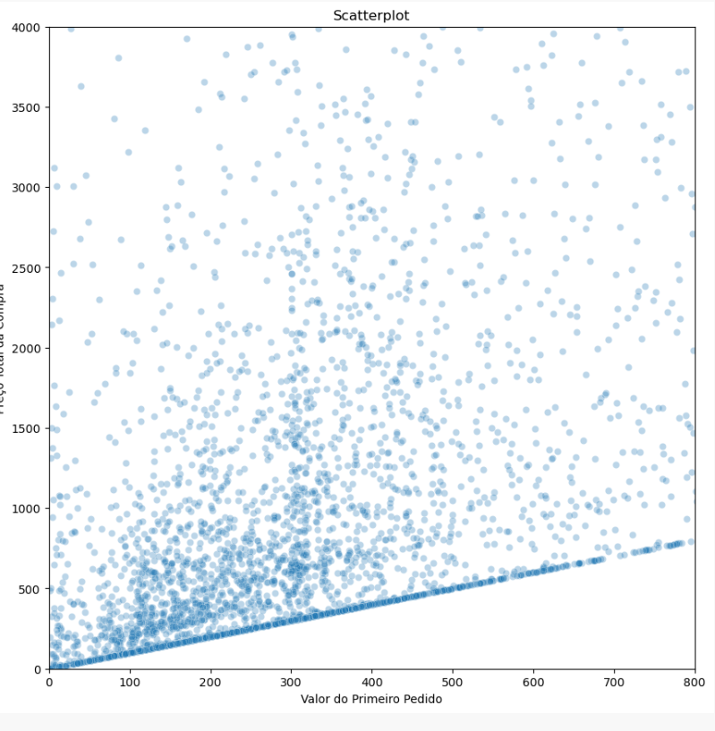

Slide 4
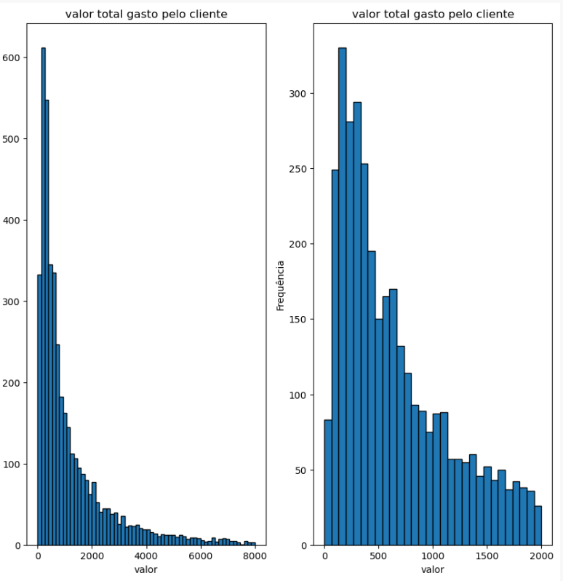

Slide 5
